Slide 1


KLS's Gogte Institute of Technology
Department of Computer Science & Engineering
Course Name: Block Chain Management
Course Code: 18CS743
Unit II : Blockchain Basics
Assistant Professor,
Ravi U. Kalkundri

Slide 2
Grasping Blockchain Fundamentals

Slide 3
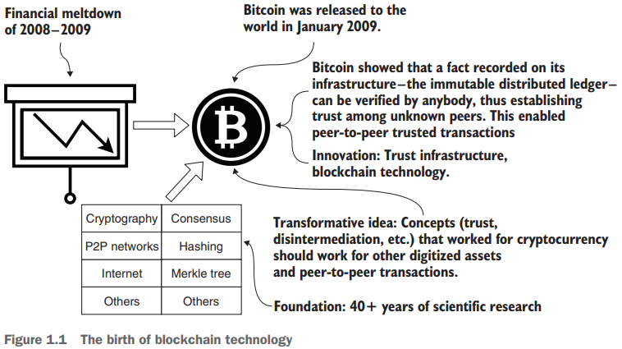
Tracing Blockchain’s Origin
Even though Bitcoin appeared to have launched suddenly in 2009, the idea of a working digital currency has been a quest since the dawn of computing.
Bitcoin’s blockchain technology stands on a strong foundation of more than 40 years of scientific research in cryptography, hashing, peer-to-peer networks, and consensus protocols.
Figure 1.1 provides a brief history of blockchain, its innovation and robust scientific foundation, and its transformative effect on modern networked systems.

Slide 4
1.1 From Bitcoin to blockchain
The initial excitement about blockchain technology was about enabling peer-to-peer transfers of digital currency to anybody in the world, crossing human-created boundaries (such as the borders of countries) without any intermediaries such as banks.
DEFINITION: “A transaction recorded on a blockchain contains a peer-to-peer message that specifies the operations executed, data parameters used for the execution of operations, the sender and receiver of the message, the transaction fee, and the timestamp of its recording”.

Slide 5
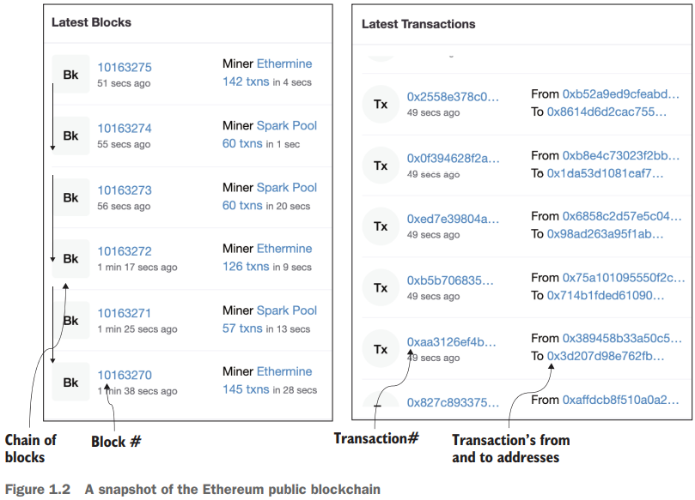
1.1 From Bitcoin to blockchain
Ethereum is a decentralized, open-source blockchain with smart contract functionality. Ether is the native cryptocurrency of the platform.
Ethereum is a technology that's home to digital money, global payments, and applications.
Figure 1.2 also shows blocks of Txs. Each block (Bk) is made up of a set of transactions and is identified by a block number. Block #10163275 has 142 Txs, and block #10163274 has 60 Txs. You may see a different set of blocks when you visit the site.

Slide 6
1.2 What is blockchain?
A blockchain is a technology for enabling trust in a decentralized system of transacting peer participants.
The purpose of a blockchain is to verify and validate (or reject, if not valid) a transaction initiated by a participant, and then execute the transaction and record the proof of these actions with the consensus of the peer participants.

Slide 7
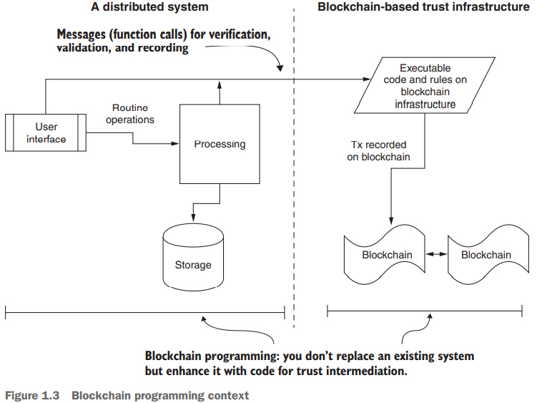
1.2 What is blockchain?
As shown in figure 1.3, the blockchain-based trust infrastructure exists within a larger system.

Slide 8
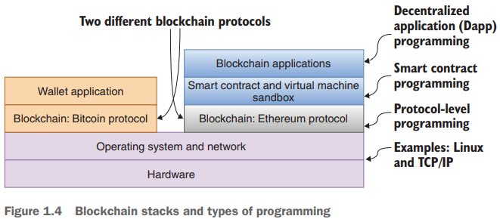
1.2 What is blockchain?
A blockchain is a technology for enabling trust in a decentralized system of transacting peer participants.
To help you further understand blockchain programming, let’s examine the blockchain stacks for Bitcoin and Ethereum, shown in figure 1.4.
These stacks represent the two models of blockchain in its short history.
Bitcoin has only the wallet application, whereas Ethereum features programmable code called smart contracts

Slide 9
1.2 What is blockchain?
Figure 1.4 also shows the three levels of programming:
Protocol-level programming—This level involves software that is needed for the deployment and operation of the blockchain itself. This software is similar to your operating system or networking software.
Smart contract-level programming—One level above is smart contract (or rules engine) programming, where you design and program the rules for verification and validation, and specify the data and messages that are to be recorded on the underlying blockchain. The smart contract is the engine that drives the blockchain on behalf of the user application.
Application-level programming—This level involves programming using web (or enterprise or mobile) application frameworks and user interface design concepts that are outside the blockchain protocol.

Slide 10
1.2 What is blockchain?
DEFINITION: “Dapps are web or enterprise applications that include application logic to invoke blockchain functions that implement trust intermediation”.
Dapps embed a significant code element—that of smart contracts. For any given smart contract, an exact copy of the smart contract’s code is transmitted through a special transaction and deployed in the participant nodes of a blockchain network.
DEFINITION : “A smart contract is an immutable executable code representing the logic of a Dapp”.
The data variables and functions defined in a smart contract collectively represent the state and operations for enforcing an application’s (Dapp’s) rules for verification, validation, and recording on the blockchain.

Slide 11
1.3 Blockchain Programming
Four fundamental concepts play a significant role in making blockchain programming different, the four key roles fulfilled by a blockchain are:
Decentralized infrastructure
Distributed ledger technology
Disintermediation protocol
Trust enabler

Slide 12
1.3 Blockchain Programming
1. Decentralized infrastructure
Special computing hardware and software stacks support the blockchain protocol, smart contracts, and applications.
What is a decentralized system?
Participants communicate peer to peer.
Participants are in control of their assets, digital or otherwise (such as an audio file, a digital health record, or a piece of land).
Participants can join and leave the system as they wish.
Participants operate beyond the typical boundaries of trust (such as within a university or a country).
Decisions are made by the distributed participants, not by any central authority.
Intermediation is achieved by the use of automated software such as a blockchain

Slide 13
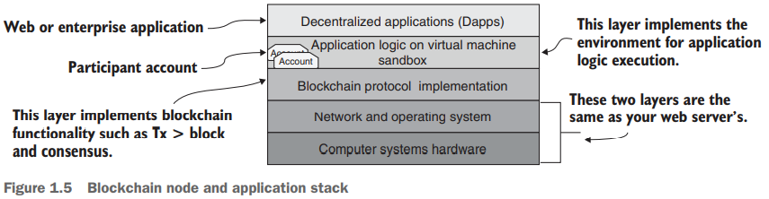
1.3 Blockchain Programming
1. Decentralized infrastructure
BLOCKCHAIN NODES, NETWORKS, AND APPLICATIONS
Consider air traffic. Flights have origins and destinations, and stopover airports and waypoints form the airline networks. Similarly, blockchain nodes host the computational environment that serves as endpoints of transactions and also performs other functions, such as relaying and broadcasting transactions.

Slide 14
1.3 Blockchain Programming
1. Decentralized infrastructure
A blockchain application is not a single-user application.
It typically connects a large number of participants through its network of nodes.
Each node can host multiple accounts to identify the different customers it services. A node can also host more than one Dapp, such as one for a decentralized supply chain management system and another for a decentralized payment system.

Slide 15
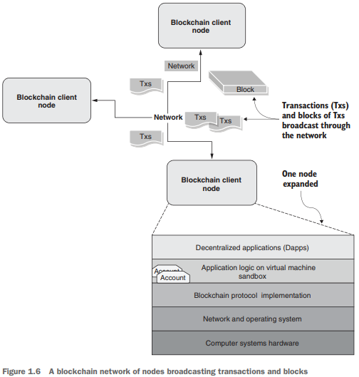
1.3 Blockchain Programming
1. Decentralized infrastructure
Figure 1.6 shows a network of three nodes connected by a network. The network facilitates broadcast of the
transactions initiated by users
blocks formed out of the transactions

Slide 16
1.3 Blockchain Programming
1. Decentralized infrastructure
The smart contracts are deployed in a sandbox environment such as a virtual machine (VM) hosted by a blockchain node.
The syntax of a smart contract is similar to a class in an OO (object-oriented) language, contains data, functions, and rules for the execution of functions.
Calling or invoking a smart contract function generates the transactions that are recorded on the blockchain, as shown in figure 1.7.
If any of the verification and validation rules fails, the function invocation is reverted.
But if the execution is successful, the generated transactions (Txs) are broadcast to the network for recording, as shown in figure 1.7.

Slide 17
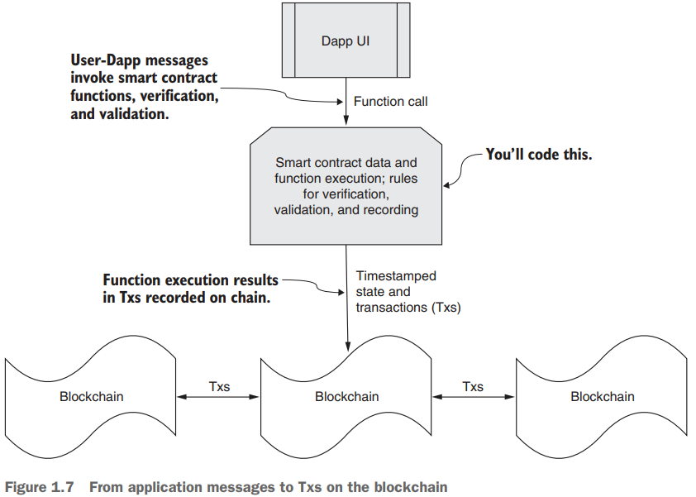
1.3 Blockchain Programming
1. Decentralized infrastructure
The figure illustrates how a function call is transformed into actions that are recorded on the blockchain.

Slide 18
1.3 Blockchain Programming
2. Distributed ledger technology
Distributed Ledger Technology (DLT) explores:
What constitutes the blockchain DLT?
The physical structure of the DLT for recording blocks of transactions
The operational details of how an application gets to use the DLT for its intended purpose: verification, validation, and immutable recording for enabling trust
The consensus algorithm (at a high level) for the integrity of the DLT

Slide 19
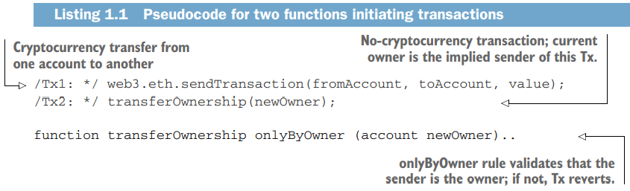
1.3 Blockchain Programming
2. Distributed ledger technology
TRANSACTIONS, BLOCKS, AND CHAIN OF BLOCKS
Applications initiate transactions and the execution of smart contract code.
A simple cryptocurrency transfer between accounts, for example, generates a “send” transaction.
Listing 1.1 shows an example pseudocode for function calls for initiating two types of transactions.
Tx1 is for the transfer of cryptocurrency.
Tx2 is an application-specific transfer of ownership of an asset from one owner to another, probably to fulfill the sale of an asset.

Slide 20
1.3 Blockchain Programming
2. Distributed ledger technology
Now that you know how transactions are generated and broadcast on a network, let’s explore how they get recorded on the blockchain.
A set of transactions makes a block, and a set of blocks make a blockchain, as shown in figure 1.8.

Slide 21
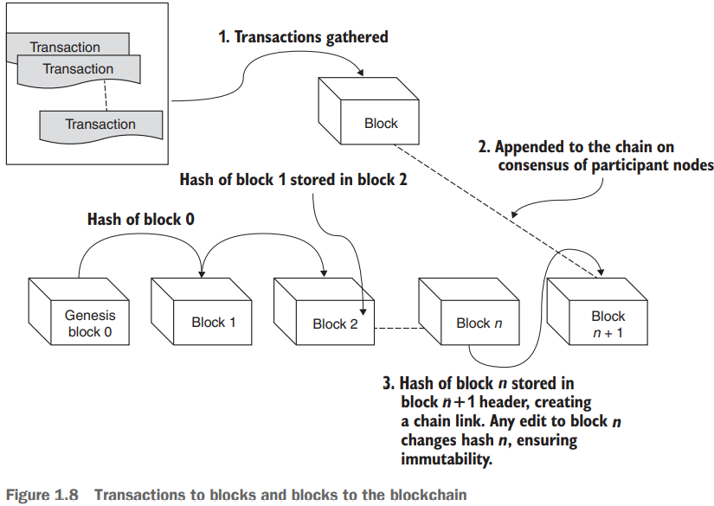
1.3 Blockchain Programming
2. Distributed Ledger Technology
The process is as follows:
Transactions on the network are verified, gathered, and pooled. Nodes select a set of transactions from the pool to create a block.
Participant nodes use a consensus algorithm to collectively agree or come to a consensus on a single consistent block of transactions to be appended to the existing chain.
A hash or representative value of the current lead block of the chain is added to the newly appended block, creating a chain link.
Distributed→ because the blockchain protocol ensures that every distributed node involved has an identical copy of the chain of blocks.
Immutable→ because each newly created block is linked to the existing blockchain by the hash value of the current head of the blockchain

Slide 22
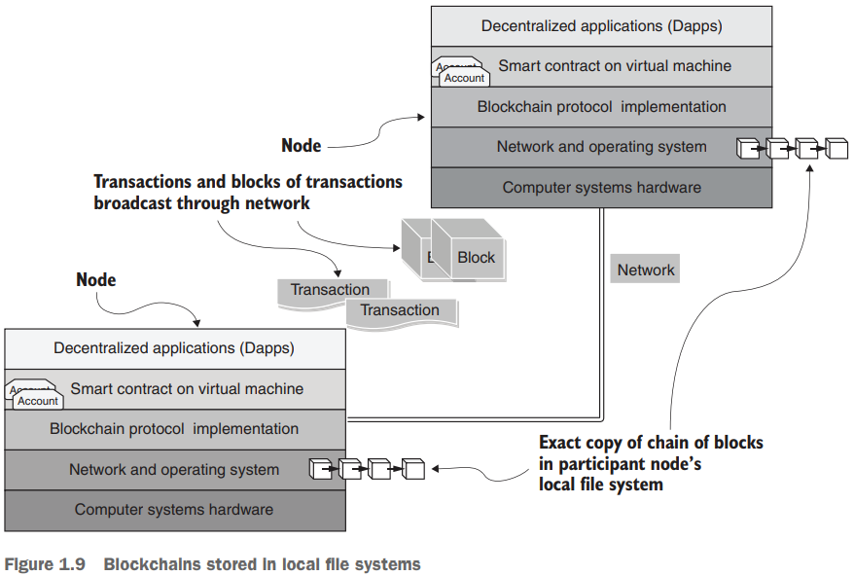
1.3 Blockchain Programming
2. Distributed ledger technology
Blockchain Stored in Local File System
The blocks of a blockchain are stored in the local file systems of the participant nodes, as shown in figure 1.9.
The chain of blocks on each node is the distributed ledger recording Txs and related data in its blocks.
Figure 1.9 depicts the fact that every node has an exact copy of the blockchain.

Slide 23
1.3 Blockchain Programming
3. Disintermediation protocol
Like any transportation infrastructure, a blockchain infrastructure has rules that you need to follow.
A blockchain protocol defines the following, among other things:
The structure of a blockchain (transactions, blocks, and chain of blocks)
Fundamental algorithms and standards for encryption, hashing, and state management
Methods for implementing consensus and a consistent chain of blocks
Techniques for handling exceptions resulting in an inconsistent ledger
The execution environment for code on the blockchain and rules for maintaining consistency, correctness, and immutability in this context

Slide 24
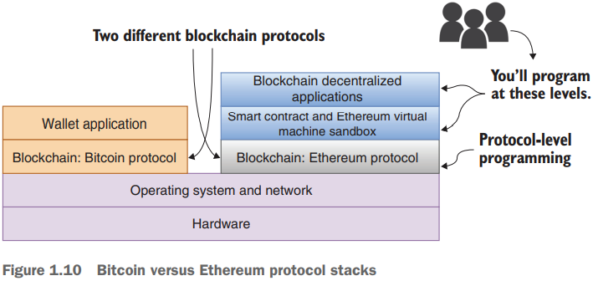
1.3 Blockchain Programming
3. Disintermediation protocol
Bitcoin VS Ethereum Protocol Stack
The Bitcoin blockchain is for the transfer of cryptocurrency, and it does that job well. It has only wallet applications for initiating transactions.
Ethereum supports smart contracts and a VM sandbox called Ethereum VM (EVM) on which the smart contracts execute. Smart contracts in turn enable decentralized operation of applications.

Slide 25
1.3 Blockchain Programming
4. Trust enabler
Nw that you know how transactions are generated and broadcast on a network, let’s explore how they get recorded on the blockchain.
Trust is critical for business and personal transactions, whether those transactions are trade, commerce, legal, medical, marital, interpersonal, or financial. Imagine a business transaction for transferring a million dollars. You have a secure channel for transfer, but are you sure you can trust the parties involved?
The three Ds— collectively enable trust in a system:
Decentralized infrastructure,
Distributed ledger technology, and
Disintermediation protocol

Slide 26
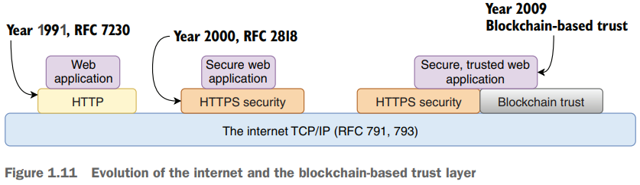
1.3 Blockchain Programming
4. Trust enabler
Figure 1.11 shows the evolution of the protocols leading to blockchain-based trust, which has yet to become a standard in the internet context.

Slide 27
Chapter 2 Smart contracts

Slide 28
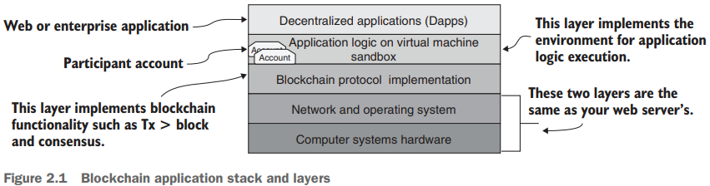
2.1 The concept of a smart contract
A smart contract is a piece of code that improves on the basic trust enabled by the Bitcoin blockchain protocol.
A smart contract addresses the need for application-specific verification and validation for blockchain applications.
It opens the trust layer of the blockchain for general-purpose applications.
The smart contract is deployed in a sandbox environment and identified by a 160-bit account address like any other participants on the blockchain network.
It executes on the Virtual Machine (VM) on the blockchain node and is identified by an account number, as shown in the figure.

Slide 29
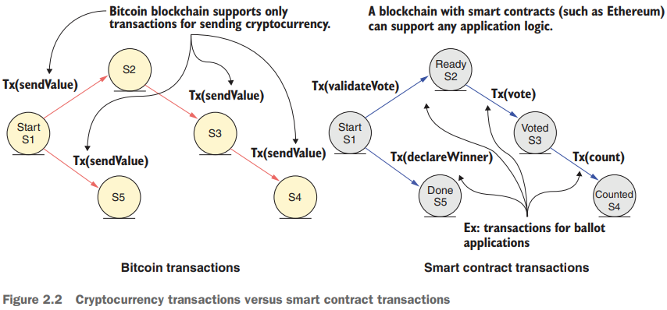
2.1 The concept of a smart contract
2.1.1 Bitcoin transactions versus smart contract transactions
Let’s compare a Bitcoin transaction and a smart contract transaction,

Slide 30
2.1 The concept of a smart contract
2.1.2 What does a smart contract do?
The smart contract acts as the brain of a blockchain application.
It is responsible for many vital functions, including the following:
It represents a business logic layer for verification and validation of application specific conditions.
It allows for the specification of rules for operations on the blockchain.
It facilitates the implementation of policies for the transfer of assets in a decentralized network.
It embeds functions that can be invoked by messages or function calls from participant accounts or other smart contract accounts.
It acts as the software-based intermediator for decentralized blockchain-based applications.
It adds programmability and intelligence to the blockchain through the specification of the parameters of its functions.

Slide 31
2.2 Design of Smart contract
Smart Contract design with a simple example that will take you through the entire process, from problem statement to code deployment.
Counters are common elements in everyday applications.
Sl. No. | System Type | Counter Example
1. | Manual System | Turnstile for counting in an amusement park
2. | Centralized system | Stock index
3. | Distributed system | Nation’s trade deficit
4. | Decentralized system | World population

Slide 32
2.2 Design of Smart contract
The counter is a simple but versatile use case that illustrates the smart contract development.
It’s important to have the correct design before developing the code.
A smart contract is deployed on the blockchain by a transaction.
It is permanently recorded on the blockchain, irreversible and unchangeable, and part of the chain of blocks, as stated in design principle 1.
DESIGN PRINCIPLE 1 Design before you code, develop, and deploy a smart contract on a test chain, and thoroughly test it before you deploy it on a production blockchain, because when the smart contract is deployed, it is immutable.

Slide 33
2.2 Design of Smart contract
Your goal in the design process is to define the contents of a smart contract; specifically, its
Data
Functions that operate on the data
Rules for operations
Design Principle 2 initiates the design process by defining the users of the system that will be served by the application.
DESIGN PRINCIPLE 2 Define the users of and use cases for the system. Users are entities that generate the actions and the input and receive the output from the system you’ll be designing.

Slide 34
2.2 Design of Smart contract
Let’s apply these principles and begin the design process for the counter problem with the standard Unified Modeling Language (UML) tools for design representation: the use case diagram and the class diagram.
The UML use case diagram helps you think through the problem and decide how the smart contract—and, more specifically, its functions—will be used.

Slide 35
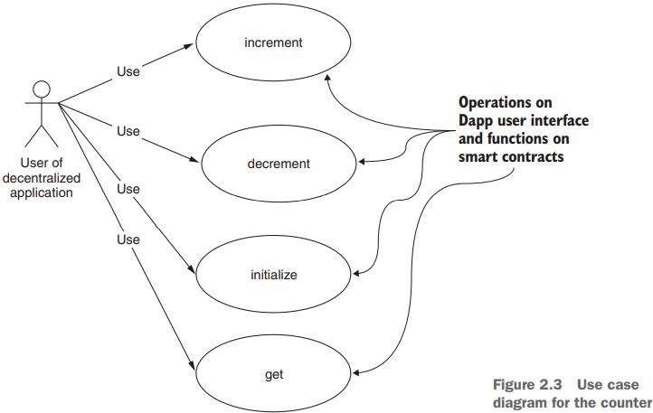
2.2 Design of Smart contract
Figure 2.3 shows just one actor: a stick figure representing a decentralized application that will use the counter.
First, let’s think about the functions of a counter:
initialize() to a value.
increment() by a value.
decrement() by a value.
get() to access the value of the counter
This diagram clearly articulates the intent of the smart contract.
This diagram is a good starting point for the design process, providing an artifact for discussion among your team members and stakeholders who are interested in the problem.

Slide 36
2.2 Design of Smart contract
2.2.2 Data assets, peer participants, roles, rules, and transactions
Now that you’ve created the use case diagram, the next step is elucidating the various attributes of the blockchain-based component of the problem.
DESIGN PRINCIPLE 3 Define the data assets, peer participants and their roles, rules to be enforced, and transactions to be recorded for the system you’ll be designing.
For this decentralized counter problem, let’s apply design principle 3 to arrive at the following items:
Data assets to track—The value of the counter
Peer participants—The applications that update the counter value
Roles of these participants—Updating the counter value and accessing its value
Rules to be verified and validated, to be applied to data and functions—None in this use case
Transactions to be recorded in the digital ledger—initialize(), increment(), and decrement()

Slide 37
2.2 Design of Smart contract
2.2.3 From class diagram to contract diagram
Now that you know how transactions are generated and broadcast on a network, let’s explore how they get recorded on the blockchain.
A set of transactions makes a block, and a set of blocks make a blockchain, as shown in figure 1.8.
UML class diagram as a guide for the design of the solution to the counter problem. A class diagram defines the various structural elements of the solution.
The typical UML class diagram of traditional object-oriented programming (OOP) shown on the left side of figure 2.4 has three components:
Name of the class
Data definitions
Function definitions

Slide 38
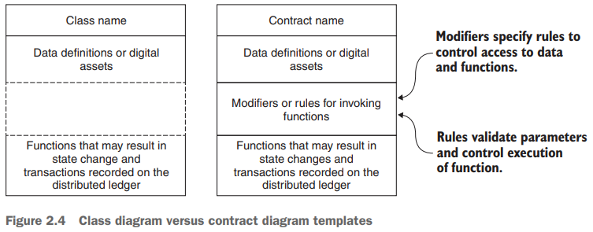
2.2 Design of Smart contract
The smart contract diagram on the right side of figure 2.4 has one additional component:
the rules for accessing the functions and data.
This component distinguishes a smart contract diagram from a traditional class diagram.
Design principle 4 deals with contract diagrams
DESIGN PRINCIPLE 4 Define a contract diagram that specifies the name, data assets, functions, and rules for execution of functions and access to the data.

Slide 39
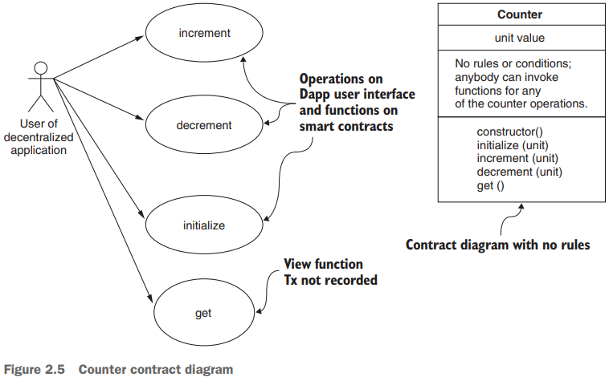
2.2 Design of Smart contract
name of the contract as Counter
data element as an integer called value
Two more functions
constructor() and
get()
The constructor, when invoked, deploys the smart contract code in the VM sandbox supported by the blockchain infrastructure.
The get() function is a utility function that returns the current value of the counter.

Slide 40
2.3 Development of a smart contract code
For smart contract development, you need a limited language customized for blockchain operations.
Solidity is one such language.
The Ethereum foundation introduced this language, but other blockchain platforms, such as Hyperledger, also support it.
You will use Solidity to code your smart contracts.

Slide 41
2.3 Development of a smart contract code
Let’s explore some of the features of the Solidity language before coding the Counter smart contract.
2.3.1 Solidity language
Solidity is an object-oriented, high-level language for implementing smart contracts, influenced by C++, Python, and JavaScript.
Solidity is statically typed and supports inheritance, libraries, and user-defined types; it also provides many useful features for developing blockchain applications.
2.3.2 Smart contract code for Counter

Slide 42
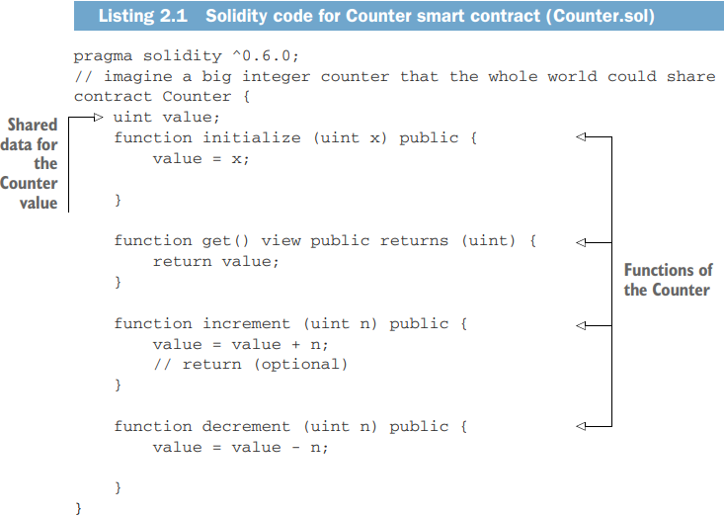
2.3 Development of a smart contract code
2.3.2 Smart contract code for Counter
contract keyword and the name of the contract
version of the Solidity language.
The uint type in the blockchain realm differs significantly from the integer data in mainstream computing: it’s a 256-bit value as opposed to 64-bit in a general-purpose language. uint, int, int256, and uint256 are aliases of one another.

Slide 43
2.3 Development of a smart contract code
2.2.3 From class diagram to contract diagram
Note that get() is a “view” function, and its invocation will not be recorded on the blockchain because it does not change the state or the value of the counter.
To create your smart contract, follow these steps:
Open the Remix web IDE in your browser.
Choose the language Solidity. (Vyper is the other language supported.)
In the IDE, click the + icon at the top of the left pane to create a new file.
In the pop-up window that opens, name the file Counter.sol. (.sol is the file type for programs written in Solidity.)
Type (enter) or copy the Counter code in listing 2.1 into the editor window

Slide 44
2.4 Deploying and testing the smart contract
2.4.1 The Remix IDE
Figure 2.6 shows the seven features of the Remix IDE that you’ll use in working with the development of a smart contract.
The Remix IDE (figure 2.6) is directly accessible at https://remix.ethereum.org.

Slide 45
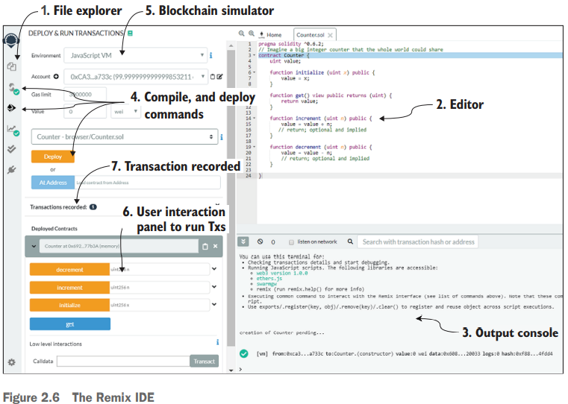
2.4 Deploying and testing the smart contract
2.4.1 The Remix IDE

Slide 46
2.4 Deploying and testing the smart contract
2.4.1 The Remix IDE
The main features of the Remix IDE include the following:
The file explorer on the left is where you create and manage your files: you can open, close, create, and delete files here.
The editor space in the middle is where you enter your code and review files, such as the .sol files of the smart contract and the .json files of transactions recorded. It also features a just-in-time compiler (optional) that points out errors as you enter the code.
The output console, just below the editor window, is where you can view the transactions and see confirmation of their recording, as well as any errors and debugging details.
The toolchain on the left panel offers icons representing commands to compile and deploy the compiled code. After clicking the Compile and Deploy icons, click the Deploy button to deploy a smart contract.

Slide 47
2.4 Deploying and testing the smart contract
2.4.1 The Remix IDE
The main features of the Remix IDE include the following:
The blockchain simulator offers an execution environment (JavaScript VM) as well as connections to live blockchain networks. The Remix IDE provides a set of account addresses and identities for the test blockchain.
The user interaction panel, in the bottom-left corner, lets you interact with a deployed smart contract to run transactions. It exposes all the public functions and data, along with buttons to invoke the functions and text boxes for input parameters.
All the transactions recorded on the blockchain are provisioned in a .json file for easy review. You can see the Transactions Recorded button in the middle of the panel on the left.

Slide 48
2.4 Deploying and testing the smart contract
2.4.2 Deployment and testing
It’s time to deploy and test the Counter smart contract. In the Remix web IDE, follow these steps:
Open the file explorer icon, and click the dark + symbol. In the box that pops up, enter Counter.sol for the name of the contract. Copy the code from the Counter.sol file into the editor window, if you haven’t done so already, and click the Compile icon. You should see a Compile button appear; when it does, click it. (You could also click the auto compile check box to skip this step.)
Make sure that the environment is set to JavaScript VM, and click the Run icon in the command menu. You should see a banner titled Counter.sol across the middle of the panel on the left.

Slide 49
2.4 Deploying and testing the smart contract
2.4.2 Deployment and testing
It’s time to deploy and test the Counter smart contract. In the Remix web IDE, follow these steps:
You’re ready to deploy and explore. Click the Deploy and Run Transactions icon. Click the Deploy button in the left panel. Then click the small down arrow next to Deployed Contracts, as shown in figure 2.7. You’ll see an interaction panel at the bottom of the screen.
You’re all set to interact with the smart contract and see it in operation. Here’s a sample interaction: enter 456 in the Initialize box, click the Initialize button, and then click the Get button to view the value. Repeat the operation by entering values in the Increment and Decrement boxes and then clicking Get.

Slide 50
2.5 What makes a blockchain contract smart?
Here are some cool features of a smart contract that make it smart. A smart contract is equivalent to any participant in a blockchain network because it has
A name
An address
A cryptocurrency balance (ether, in this case)
Built-in features to send and receive cryptocurrency (ether, in this case)
Data and functions
Built-in features to receive messages and invoke functions
The ability to reason out the execution of a function

Slide 51
2.5 What makes a blockchain contract smart?
All the participants interacting with the blockchain, including a smart contract, have an account number or address that uniquely identifies them:
Ethereum supports two types of accounts: Externally Owned Accounts (EOAs) and smart contract accounts. Both types of accounts are identified by addresses that are 160 bits, or 40 bytes, long. You can view the account numbers in the Remix IDE.
Both types of accounts, EOAs and smart contracts, can hold a balance of ethers. Thus, every account has these two implicit attributes: address and balance.
An EOA or a smart contract account can invoke a smart contract function by sending a message. This message has two implied attributes: msg.sender and msg.value. Yes, a message can carry a value that is added to the balance held by the smart contract when one of its functions is invoked. The function has to be declared with a payable modifier to be eligible to receive funds.

Slide 52
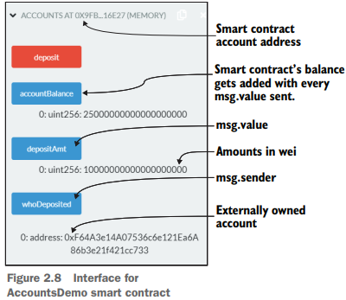
2.5 What makes a blockchain contract smart?
All the participants interacting with the blockchain, including a smart contract, have an account number or address that uniquely identifies them:

Slide 53
2.6 Decentralized airline system use case
The Airline System Consortium (ASK instead of ASC) blockchain for the airline industry enables peer-to-peer transactions of flight seats among participating airlines.
Unlike in traditional systems, airlines may join and leave this system as they wish.
An airline joins ASK by depositing a predetermined minimum escrow used for payment settlement for seats used in ASK transactions.
The consortium allows an airline to trade (buy and sell) flight seats under certain circumstances and conditions.
The rules for the trades can be codified into the system so that there are no ambiguities and the outcomes are deterministic.

Slide 54
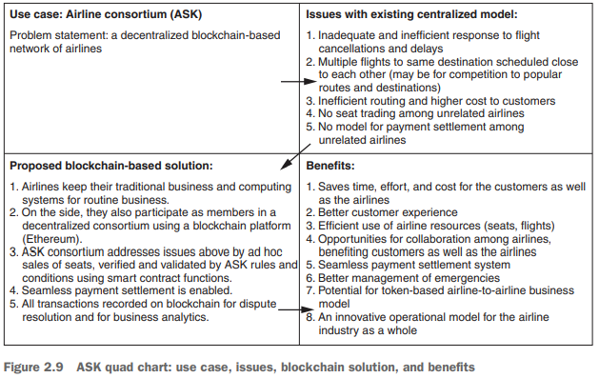
2.6 Decentralized airline system use case

Slide 55
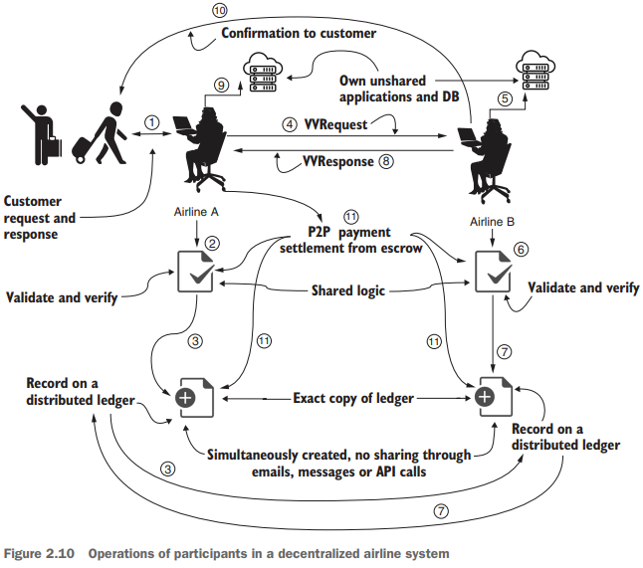
2.6 Decentralized airline system use case
2.6.2 Sequence of operations
Here are the steps followed by two airlines, A and B, that are not necessarily known to each other and that operate beyond the boundaries of traditional trust.

Slide 56
2.6 Decentralized airline system use case
2.6.2 Sequence of operations
Operations of participants in a decentralized airline system
A customer initiates a change of flight seat that they hold on airline A.
An agent or application at airline A verifies and validates the request through smart contract logic shared among the ASK consortium members.
Once verified, the request Tx is confirmed and recorded in a distributed immutable ledger.
In the simplest design, an agent at airline A sends the verified and validated request (VVRequest) to airline B.
An agent or application at airline B checks the airline’s database to check for availability.
An agent at airline B responds through shared smart contract logic that verifies and validates the common interests and shared rules of the consortium.

Slide 57
2.6 Decentralized airline system use case
2.6.2 Sequence of operations
Operations of participants in a decentralized airline system
Once verified, the response Tx is confirmed and recorded in a distributed immutable ledger. Now everyone in the consortium knows that a response has been sent.
8 Airline B sends the response (indicated by VVResponse) to the agent at airline A.
Airline A updates its database, noting that a change has been made.
An agent at airline B sends the customer the information for the flight seats and other details.
Payments are settled through peer-to-peer Txs, using the escrow or deposit that participating airlines hold in their shared smart contract. The payment settlement can be embedded in other suitable operations in the system but will be handled by the shared smart contract and recorded in the ledger.

Slide 58
2.7 Airlines smart contract
DESIGN PRINCIPLE 1 Design before you code, develop, and deploy a smart contract on a test chain, and thoroughly test it before you deploy it on a production blockchain, because when the smart contract is deployed, it is immutable.
DESIGN PRINCIPLE 2 Define the users of and use cases for the system. Users are entities that generate the actions and the input and receive the output from the system you’ll be designing.
DESIGN PRINCIPLE 3 Define the data assets, peer participants and their roles, rules to be enforced, and transactions to be recorded for the system you’ll be designing.
DESIGN PRINCIPLE 4 Define a contract diagram that specifies the name, data assets, functions, and rules for execution of functions and access to the data.

Slide 59
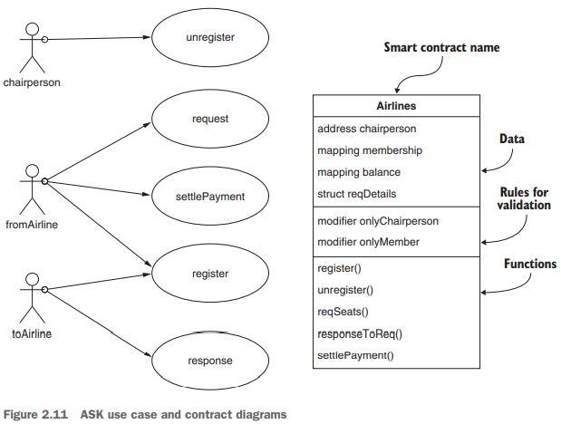
2.7 Airlines smart contract

Slide 60
2.7 Airlines smart contract
2.7.1 Peer participants, data assets, roles, rules, and transactions
DESIGN PRINCIPLE 3 Define the data assets, peer participants and their roles, rules to be enforced, and transactions to be recorded for the system you’ll be designing.
Now let’s apply design principle 3 to code the smart contract’s data structures and functions.
Identifying the participants, their roles, the assets they control, and the related transactions is a common first step in any standard design process.
This step is even more critical for users that do not necessarily operate in the same environment or within the business organization.

Slide 61
2.7 Airlines smart contract
2.7.1 Peer participants, data assets, roles, rules, and transactions
USERS: You first identify the users of the system as peer participants. This term is used to emphasize that they interact with one another in a peer-to-peer fashion, without any intermediaries.
ASSETS: The data assets are the flight seats and the funds held by the peer participants. We learned in chapter 1 that one of the fundamental tenets of a decentralized system is that peer participants—not an intermediary—hold their own assets.
ROLES The following are the roles:
Agents acting on behalf of the airlines can enroll or self-register by using the register() function with an escrow/deposit;
Agents (of members only) can request flight seats.
Agents acting on behalf of the airlines can check their centralized databases for availability and reply.
Peers settle the payment between themselves if seats are available.
The chairperson of the consortium has the sole authority to unregister members and return leftover deposits.

Slide 62
Thank You

Slide 63
2.3 Development of a smart contract code
2.2.3 From class diagram to contract diagram
Now that you know how transactions are generated and broadcast on a network, let’s explore how they get recorded on the blockchain.
A set of transactions makes a block, and a set of blocks make a blockchain, as shown in figure 1.8.
UML class diagram as a guide for the design of the solution to the counter problem. A class diagram defines the various structural elements of the solution.
The typical UML class diagram of traditional object-oriented programming (OOP) shown on the left side of figure 2.4 has three components:
Name of the class
Data definitions
Function definitions

